Slide 1
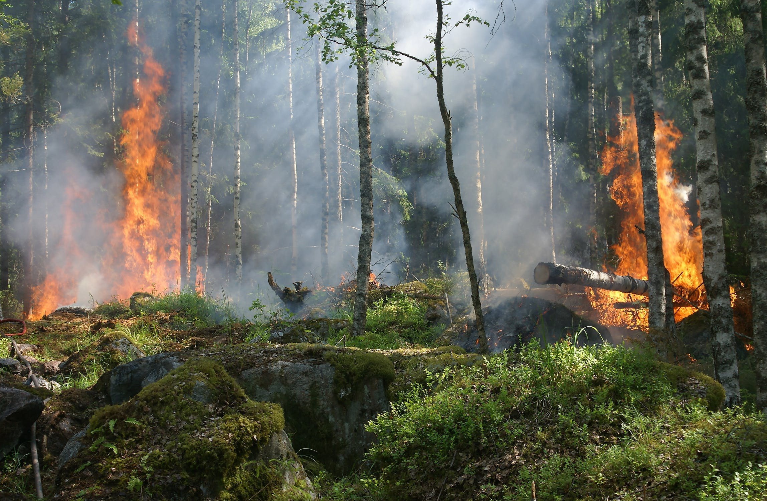


FINAL YEAR PROJECT PRESENTATION
Simon GABORIT
BEng Software & Electronic Engineering Y4
Supervisor: Brian O’Shea

Slide 2
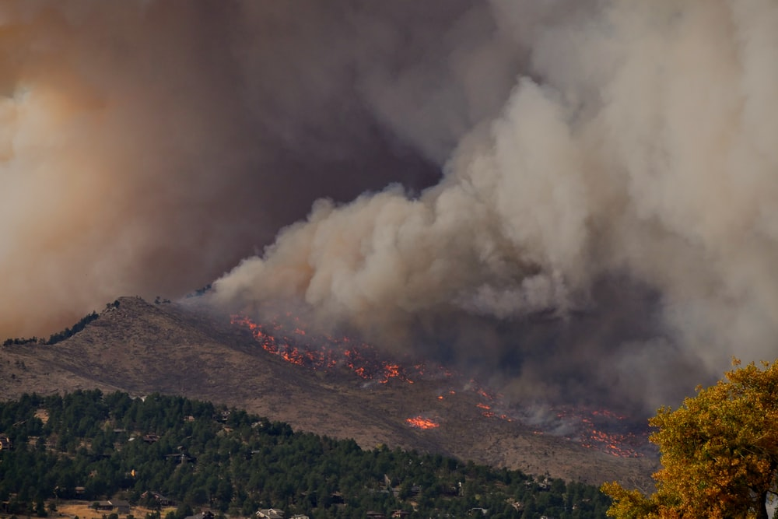
INTRODUCTION
WHAT
Network of towers
Database
Web page – Maps
Weather Forecast
WHY
Destructive Wildfires
Ecological impact
Monitor Situation – Not easy accessible Area

Slide 3

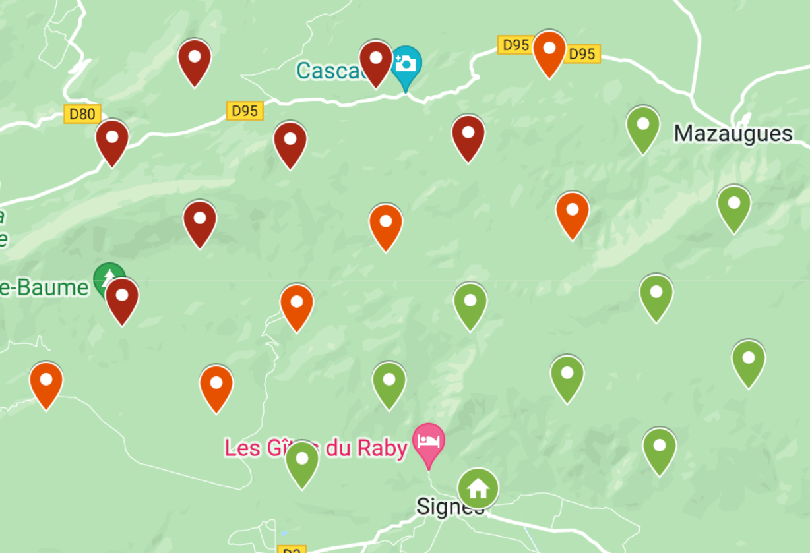
WEB PAGE
3 Pages
Introduction page
Maps page
Forecast page

Slide 4
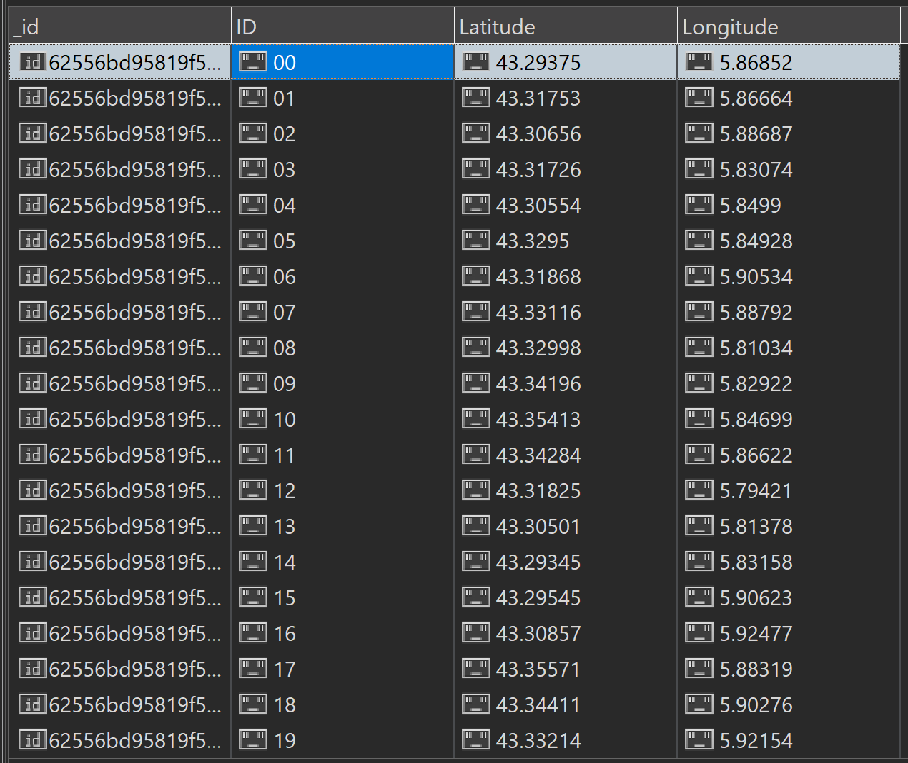
BACKEND
MongoDB
Data Container
Node.Js
Connection to Database
Express
Mongoose

Slide 5
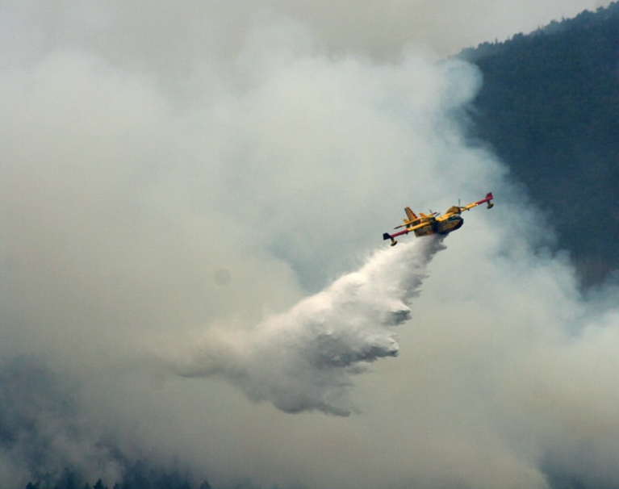
CONCLUSION
Underestimated problems/work
Difficulty of project management
Development of skills
Pleasure to work on Project
Career plans

